Slide 1
“Utilising a gene-drive to induce infertility in mosquitos to reduce the spread of mosquito-borne diseases”
Milan Singh
Qurratu Aini Hashim
Dimitar Dimitrov
Joey Martinez

Slide 2

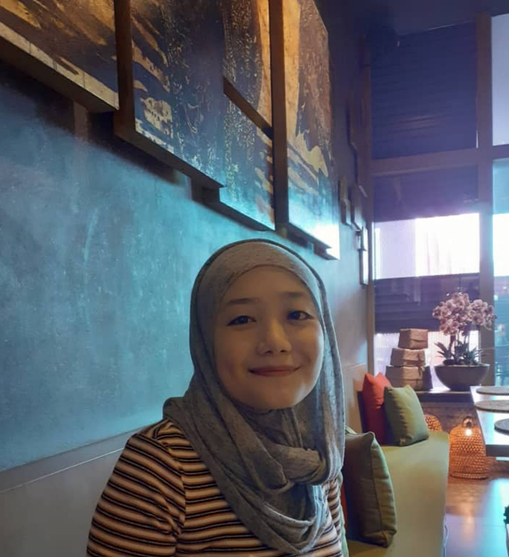
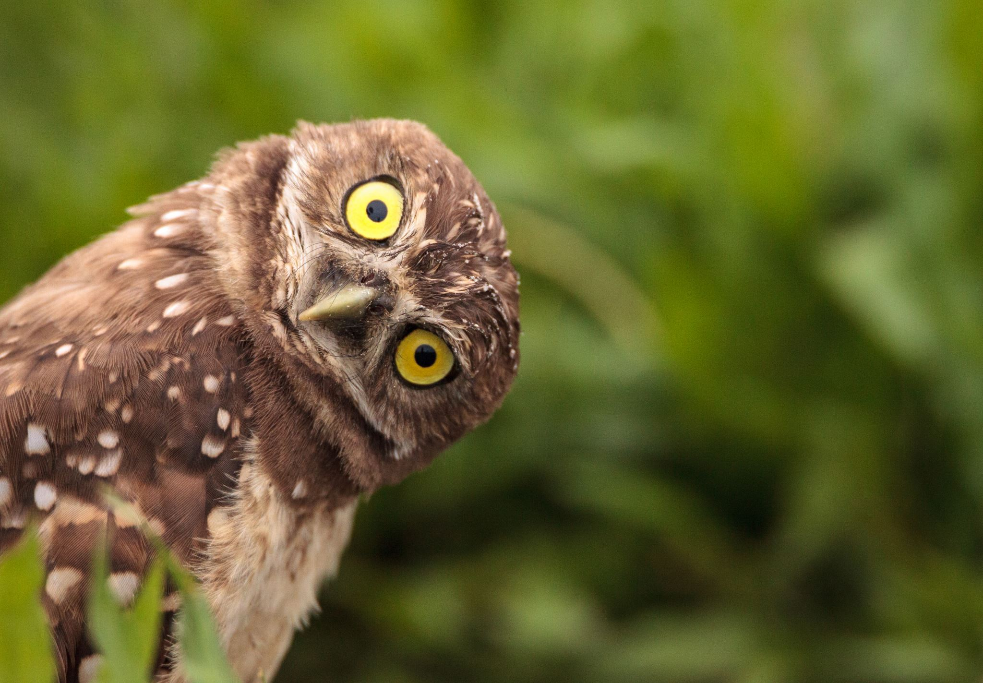
AediniGem
Qurratu Aini Hashim
Dimitar Dimitrov
Translation in:
Malay, German, Mandarin, Spanish?, Tagalog?, Italian, Punjabi, Russian, Bulgarian
Milan Singh
Josephine Martinez

Slide 3
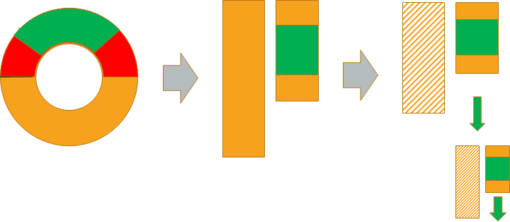
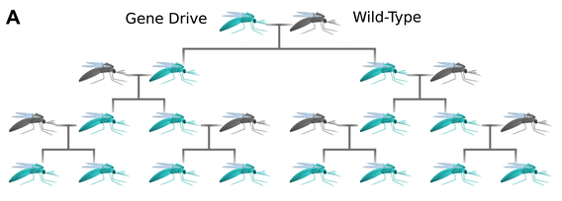
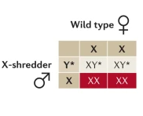
X-shredder gene drive
- Male mosquitos don’t suck blood
- Inserting an X-shredding CRISPR system makes all progeny male
- Eventually the species is driven to extinction by lack of mating partners
- Proof of concept based on N. Windbichler et al., 2007
Source: http://dx.doi.org/10.7554/eLife.03401.002
Source: https://www.nature.com/articles/nrg.2015.34

Slide 4
Past Examples
Results
Results
https://doi.org/10.1371/journal.pntd.0003864
Results
Results
Study #1
Results
Results
Study #1
Results
Results

Slide 5
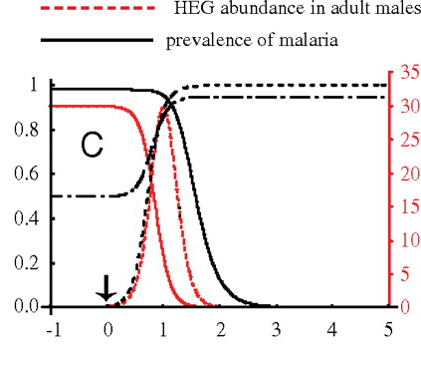
Mathematical Modeling
- A. Deredek et al. from Imperial created a mathematical model for the spread of malaria partially based on the Windbichler experiment
- They assumed a single zinc-finger endonuclease X-shredder against An. Gambiae mosquitos spreading malaria
- The model showed that a release of a GM population of males equal to 1% of the wild local population could drive it to extinction within a year
Source: https://www.pnas.org/content/108/43/E874
Notes:
- We will be using a CRISPR system with higher rates of homing and multiple sites
- It is by far the fastest method out of all of the models
- Collaborating with BGU Israel lead us to Dr. Deredek

Slide 6

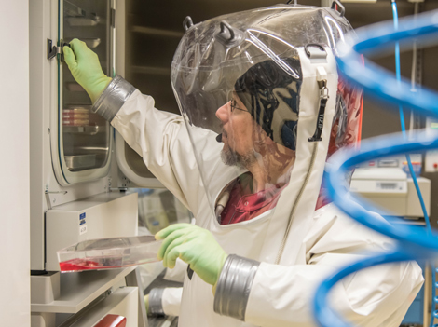

Safety
Reversible Gene Drives (Wyss Institute collaboration)
HSE Genetically Modified Organisms (Contained Use) Regulations 2014
Class 4 Lab
General administrative tasks:
Instructions for use of equipment (e.g. Microbial Safety Cabinets, fume cupboards, incubators)
Disinfection procedures and waste handling
Storage of reagents, GMO, and pathogenic procedures
General administrative tasks:
Spillage procedures
Accident, incident, and fault reporting procedures
Packaging for transport
Risk and COSHH assessment

Slide 7



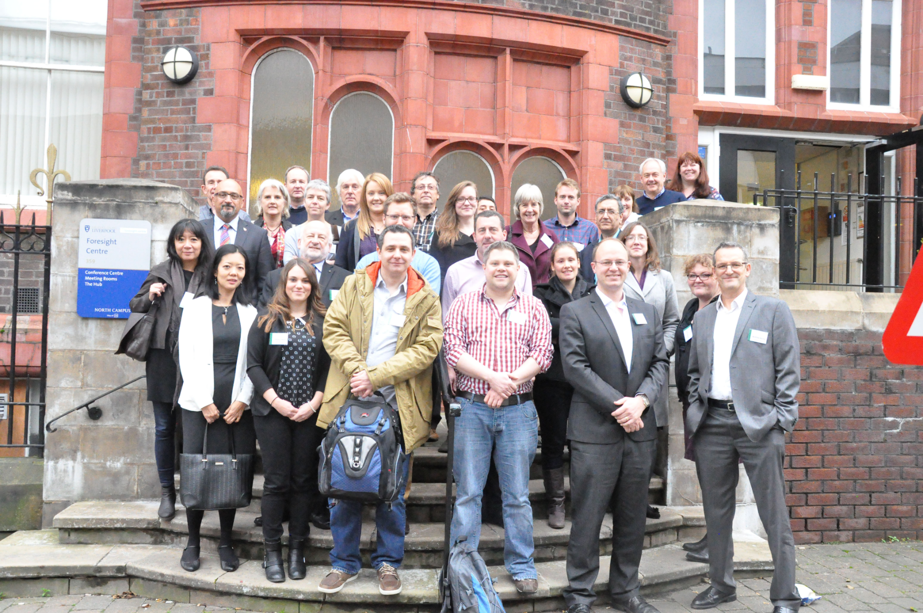
Public Engagement, Collaboration, and Inclusivity
SynBio Outreach Program (have competitions; extend to Mentoring Program)
BGU Israel
(Professor Deredeck)
Vector-Borne Diseases in the UK – Biennial Meeting
Nationwide Initiative

Slide 8




Human Practices
King's Department of Population Health Sciences
Encephalitis Society UK
Malaria No More UK
First Rounders Podcast from Nature Biotechnology

Slide 9
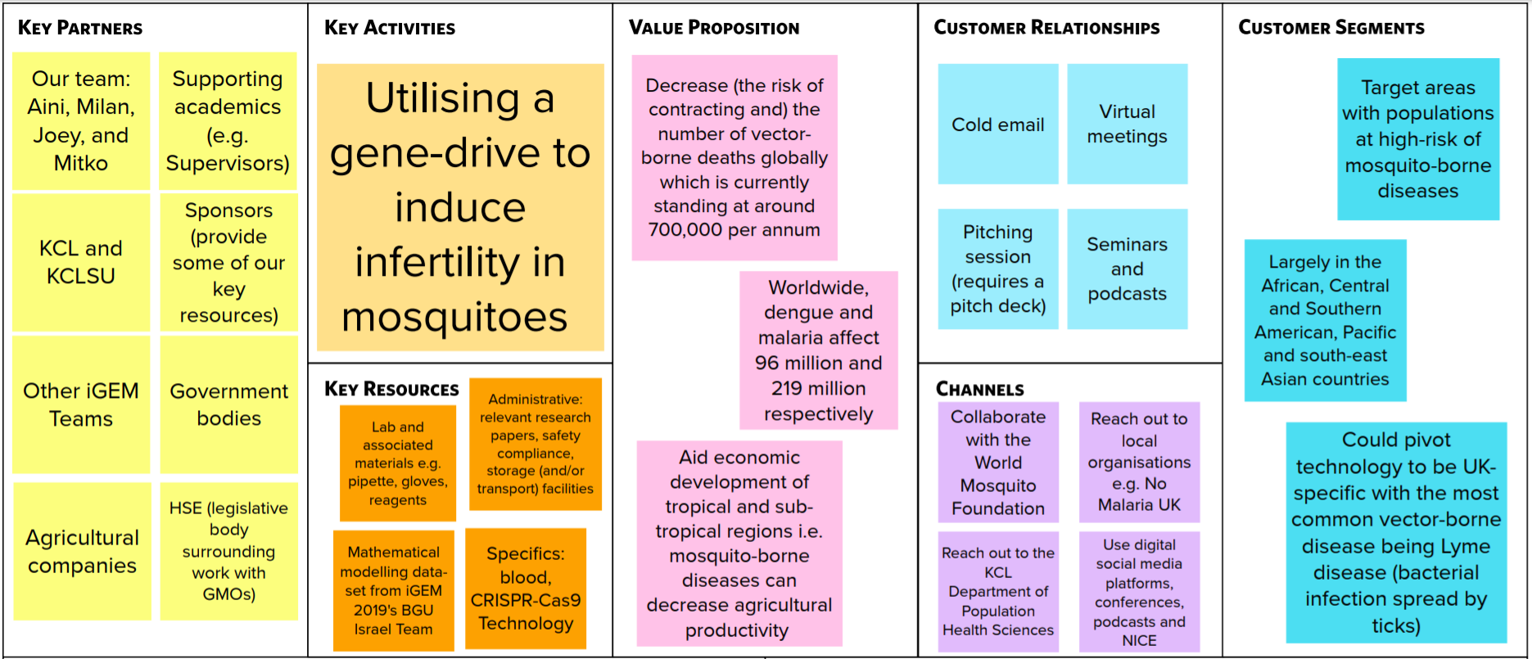
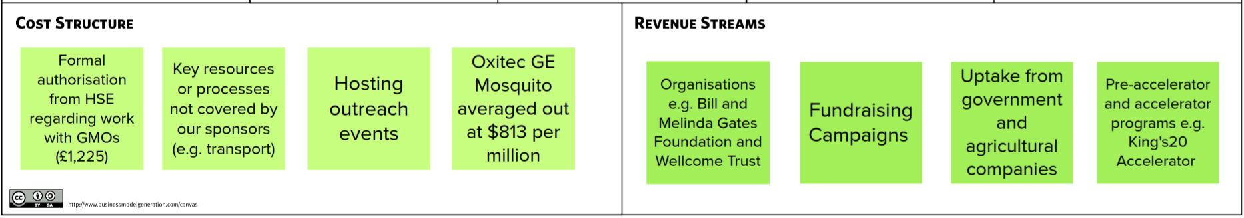
Entrepreneurship and marketing

